Slide 1

Stock Management Application
Paliyal Shreshth
Palle Punil Kumar Reddy
Gunamgari Eshwar Chandra Vidya Sagar Reddy
Bhuvanesh Gadamsetty

Slide 2
Introduction:
This application is designed to manage stocks for companies and organizations and also handle the sale and purchase of their products. The stock management system includes different modules and features for adding, editing, viewing, and deleting items.

Slide 3
Actors
Admin : Add/Edit/Delete/View customer details.
Stock module : Stock management.
Dispatch Module : Dispatch module to dispatch

Slide 4
Services :
Customer
Products
Suppliers
Dispatch

Slide 5
Data Bases :
Customer Data Base : Customer table
Products Data Base : Products Table
Dispatch Data Base : Dispatch Table
Supplier Data Base : Supplier Table

Slide 6
Enter stock
View stock
Dispatch stock
Remove stock
Admin can control these features:

Slide 7
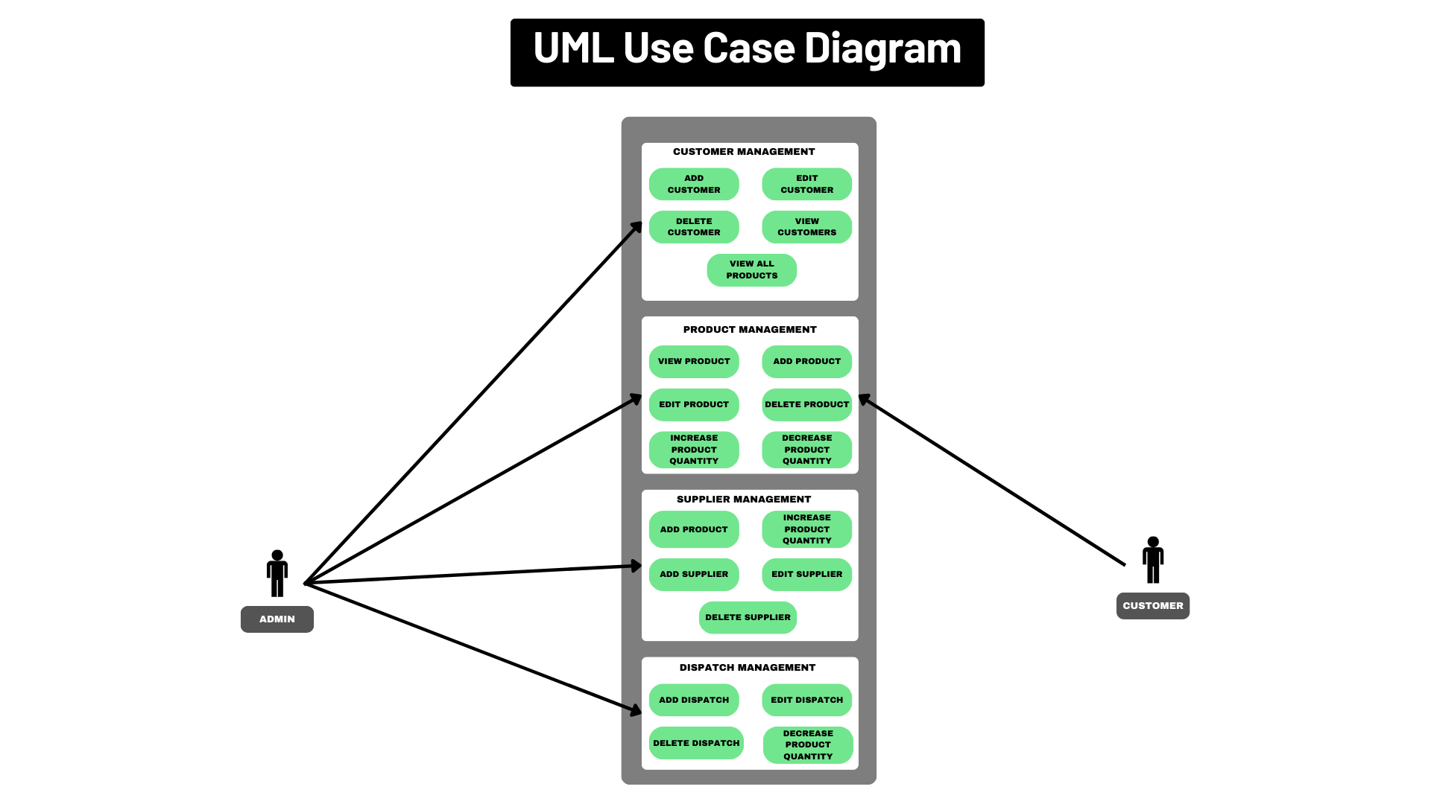

Slide 8
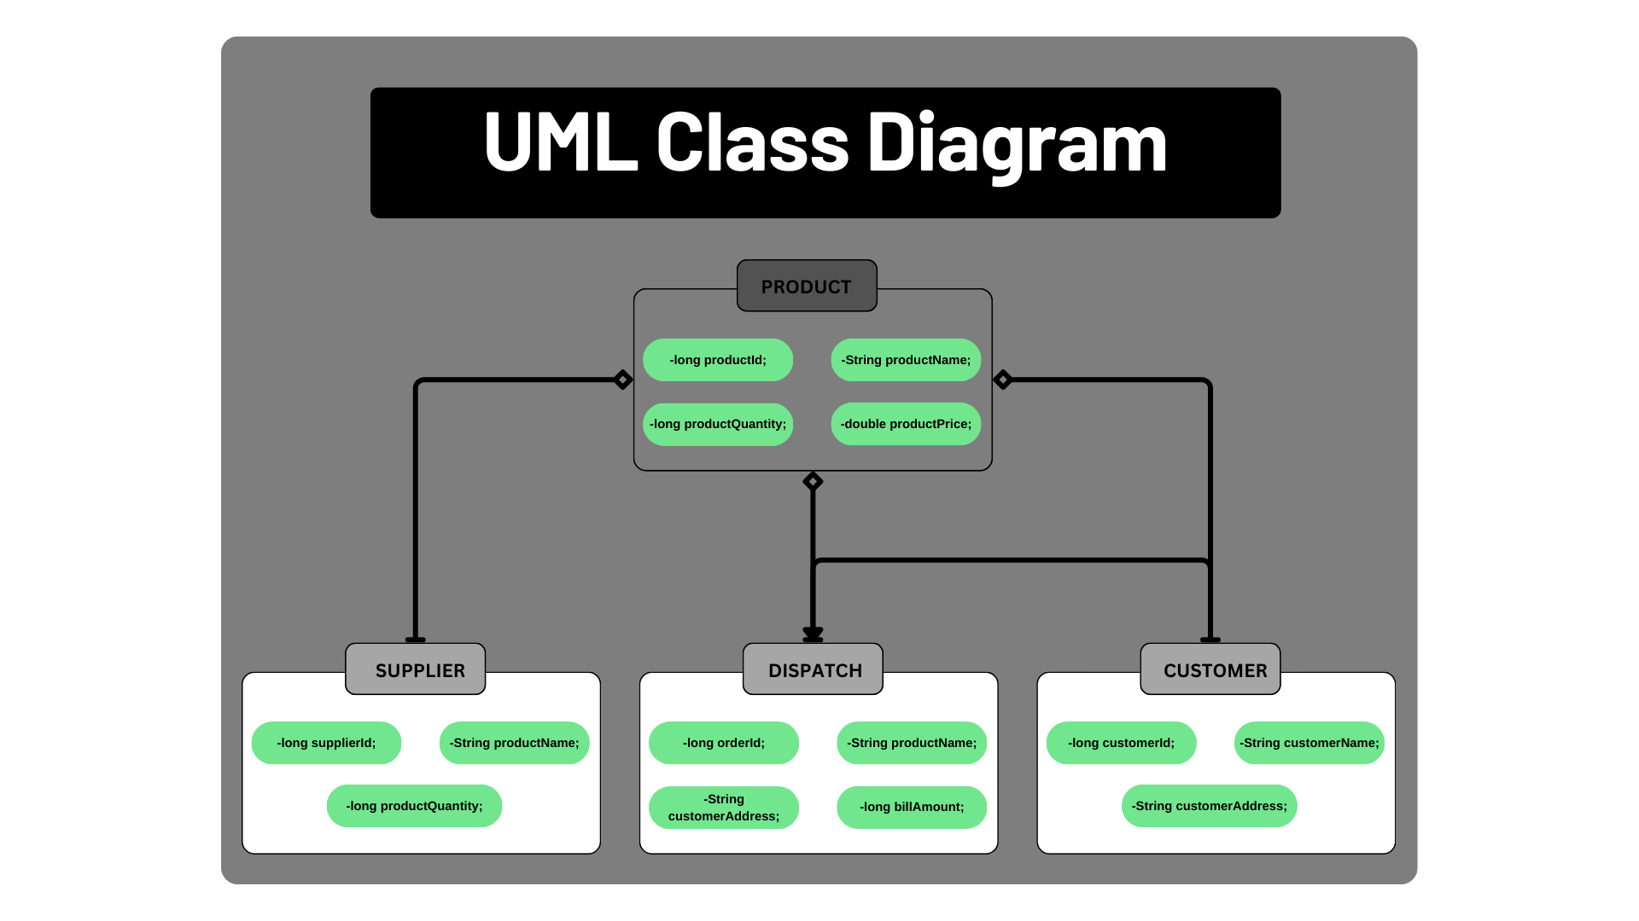

Slide 9
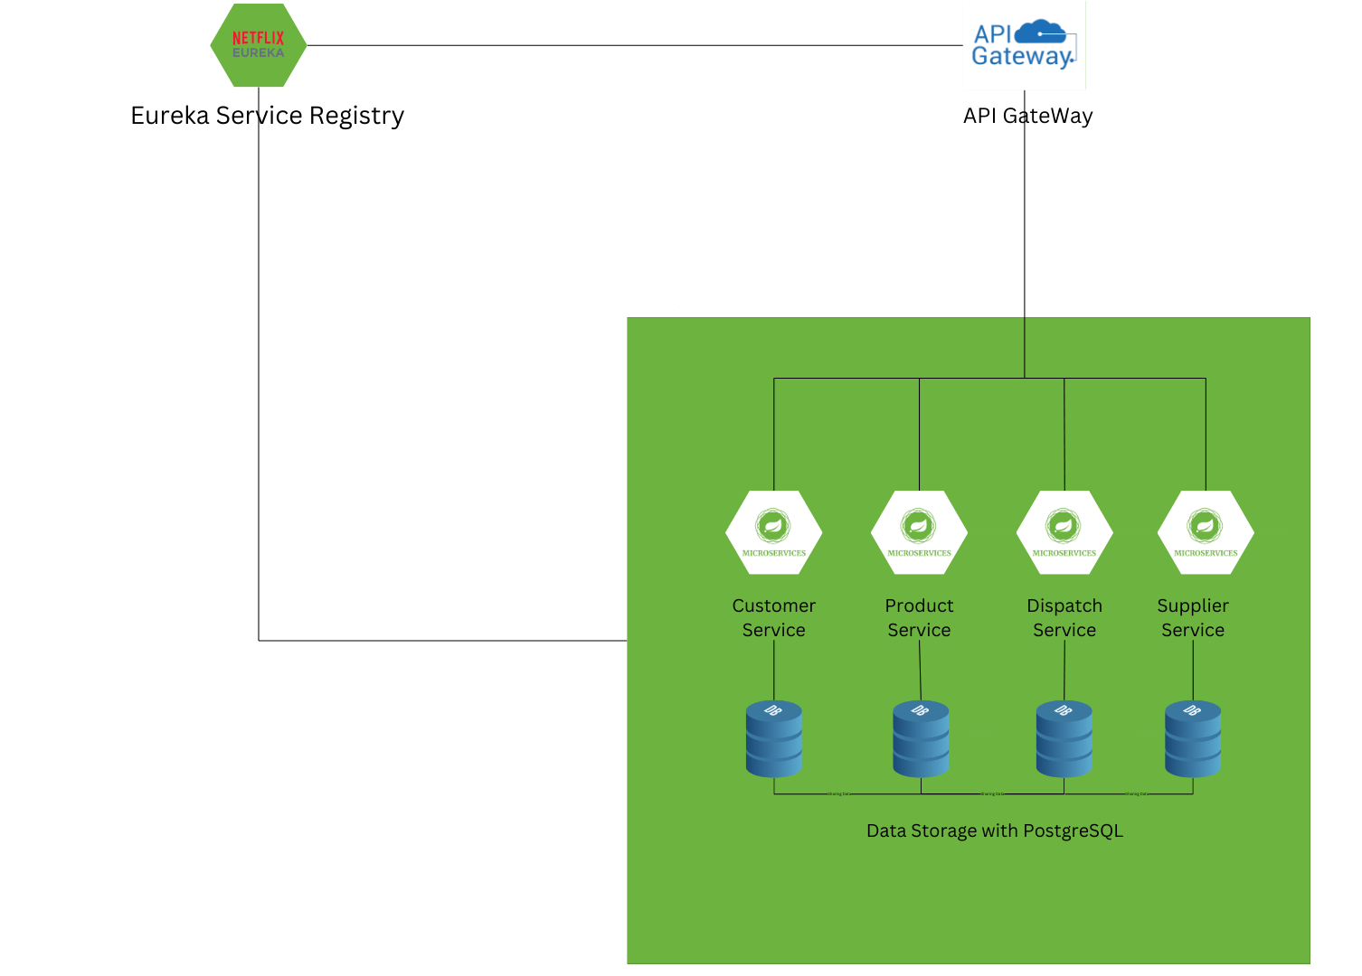
Activity Diagram

Slide 10
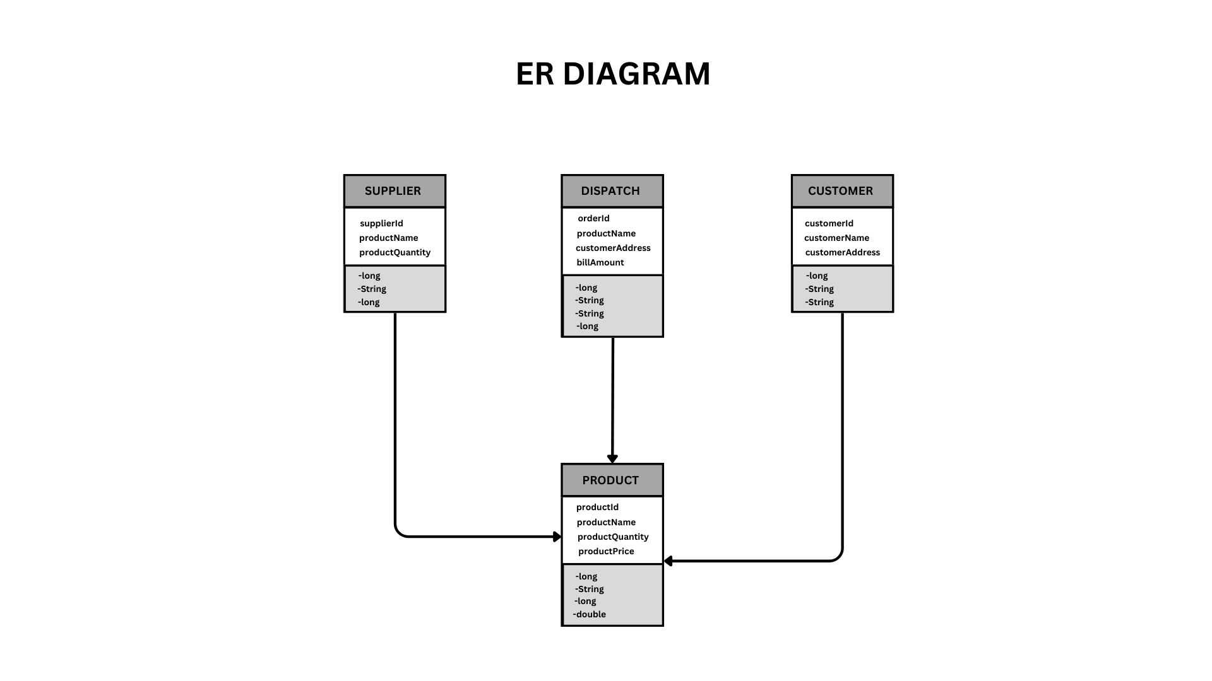
ER Diagram

Slide 11
Use application.properties or application.yml
Use application.properties or application.yml
Concepts Implemented:
Building REST APIs: Create endpoints for CRUD operations.
Exception Handling:
JWT: Implement JSON Web Tokens for stateless authentication
Configuration Management
Spring Boot Actuator: Monitor your application with built-in endpoints
Spring Cloud: Use Spring Cloud components like Eureka
Spring Security: Secure your application with authentication and authorization

Slide 12
Technology Used :
Java
PostegreSql
Spring Boot

Slide 13

Thank You

